Slide 1
Rockbuster Steath Launch Strategy
Done By,
Sai Vishwanath Chilukuri

Slide 2


Slide 3
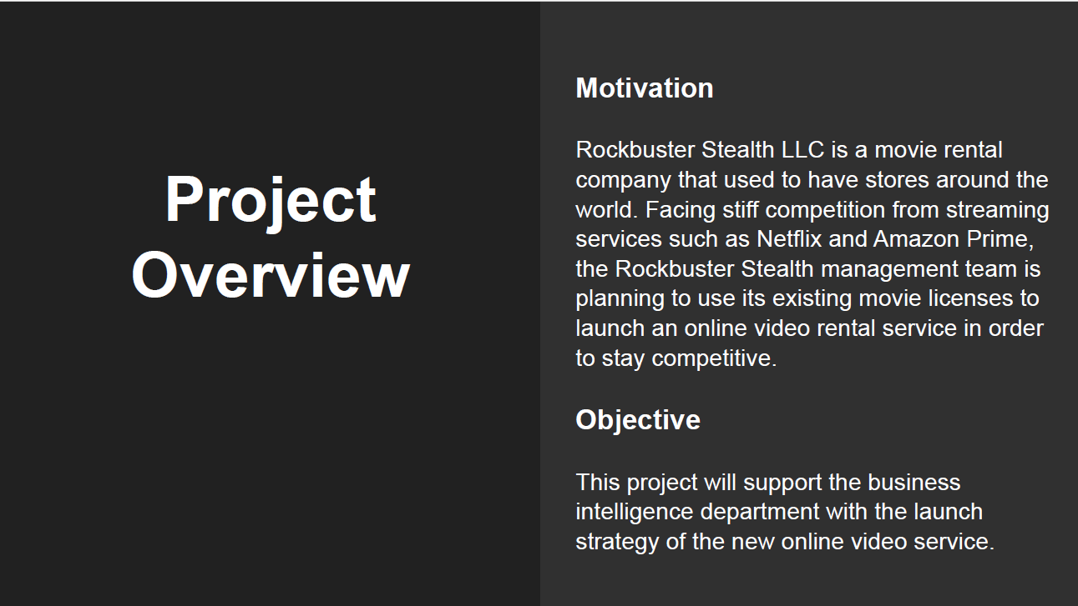

Slide 4
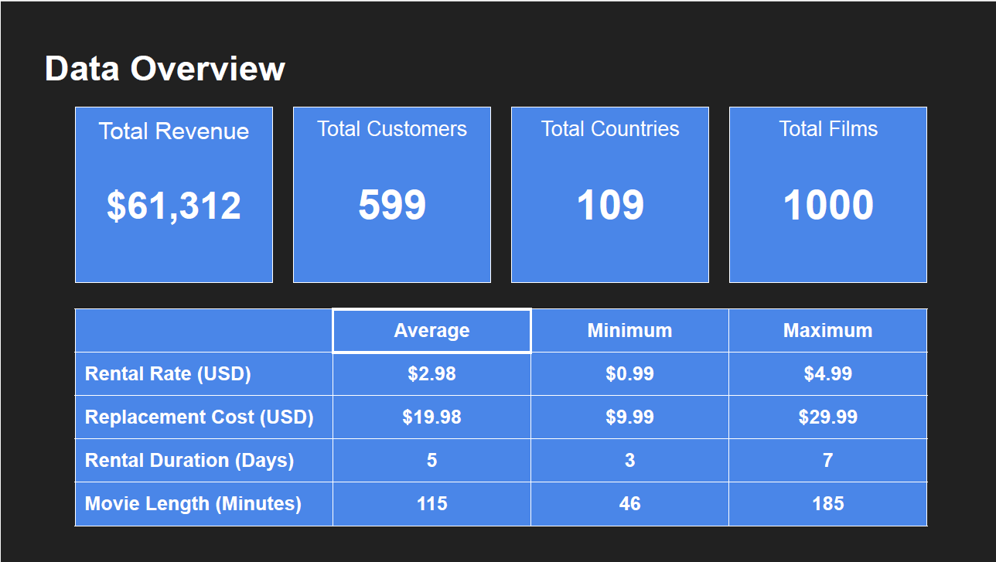

Slide 5
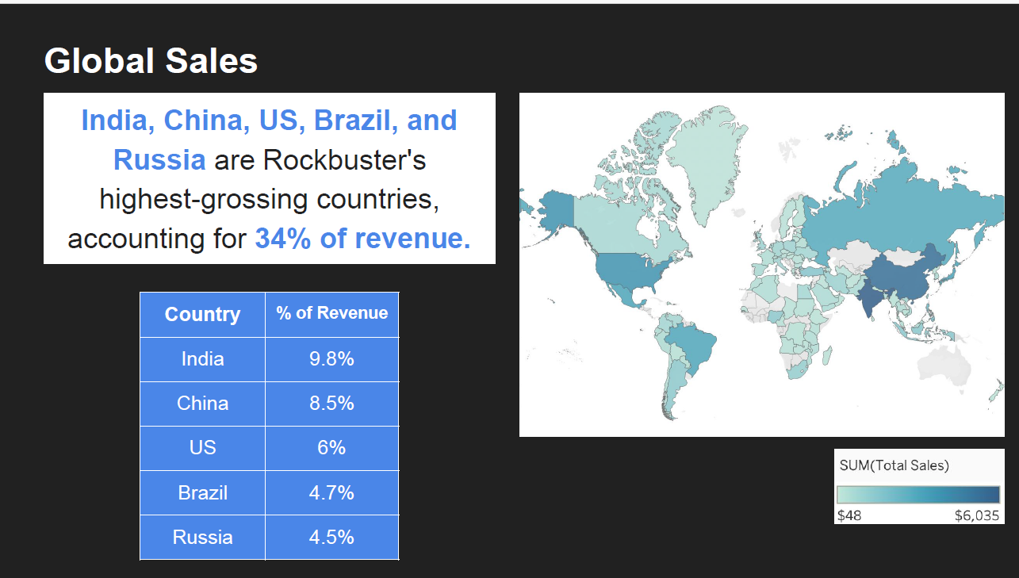

Slide 6
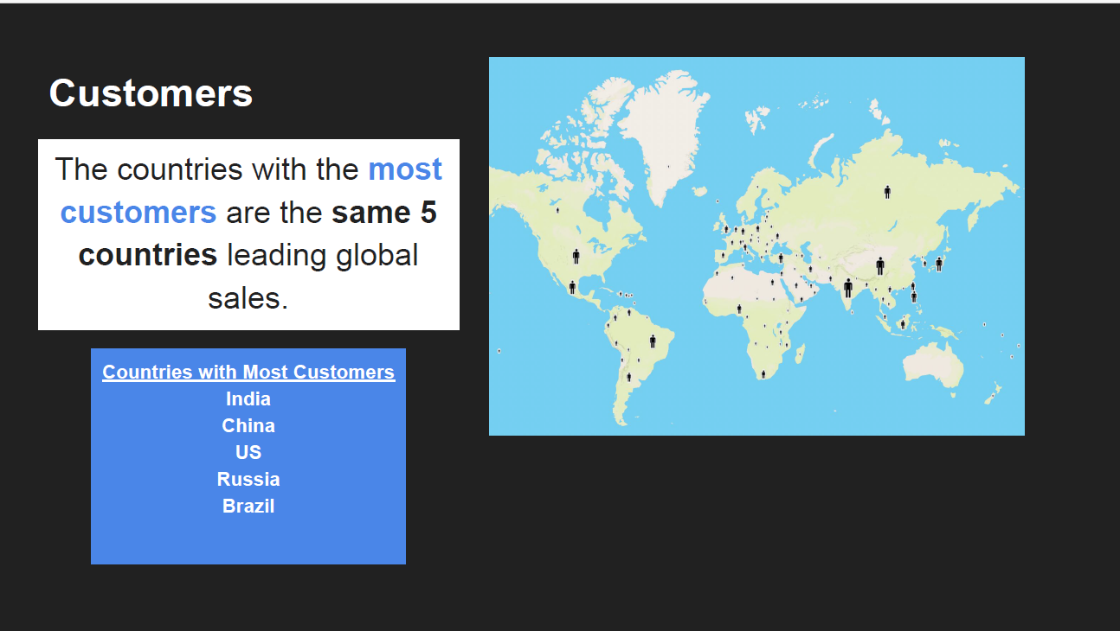

Slide 7


Slide 8


Slide 9
